Slide 1
Director’s Review
Filing & Winning
June 2019

Slide 2
Why this process?
The State had originally argued a “restructure” is not a “reallocation” and the Director’s Review process shouldn’t apply.
When the Unions bargained over this Re-Structure, we proposed re-evaluating everyone once the first round was complete.
We had concerns about consistency, terminology, quality of the documentation, understanding of the impacts.
Because of how long the process has already taken, we eventually compromised on using the existing Director’s Review process.

Slide 3
DIRECTOR’S REVIEW is an Appeals process run by the State Office of Financial Management, not by your Agency or College.
WAC 357-49-010
For what actions may an individual request a director's review?
An individual may request a director's review of:
(1) Allocation or reallocation per WAC 357-13-080;
(2) Remedial action per WAC 357-19-430 or 357-19-450. Requests for remedial action must be received within thirty calendar days of the date the individual could reasonably be expected to have knowledge of the action giving rise to violation of the nonpermanent appointment or temporary appointment rules;
(3) Removal of an individual's name from a layoff list as specified in WAC 357-46-145; or
(4) Performance evaluation process or procedure per WAC 357-37-080.

Slide 4
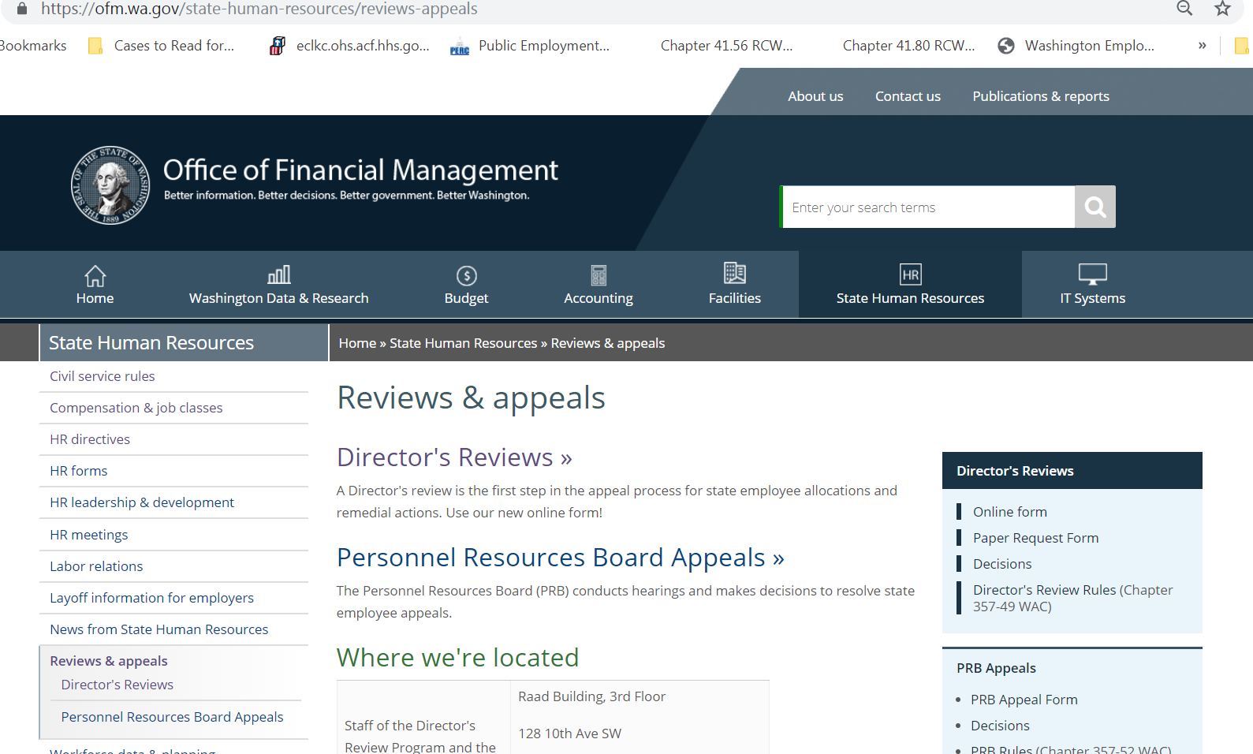

Slide 5
1st Steps
The Director’s Review Office handles all appeals of re-classes statewide, not only appeals in a re-structure like this one.
If you have appealed your classification before (say, to move from ITS 2 to ITS 3) this is the same process.
They’ve recently streamlined in anticipation of hearing from all of you!
Your appeal can now start with filling out a simple online form, available at
https://ofm.wa.gov/state-human-resources/reviews-appeals/directors-reviews

Slide 6
30-day appeal window
WAC 357-13-080
Can an employee request a director's review of a position review or reallocation of the employee's position?
An employee may request a director's review of the results of a position review or reallocation of the employee's position, per WAC357-49-010. The employee must request the director's review within thirty calendar days of being provided the results of a position review or the notice of reallocation.
* * *
Because this is statutory, the Director’s Review Office CANNOT accept a late appeal, even if they want to.

Slide 7
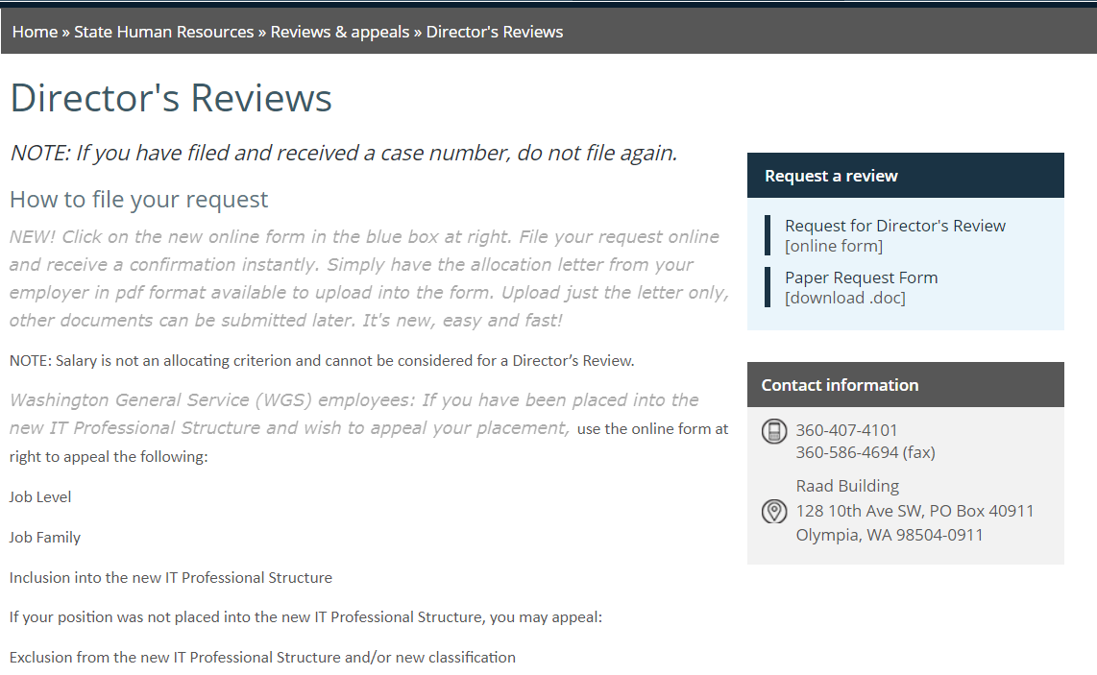

Slide 8
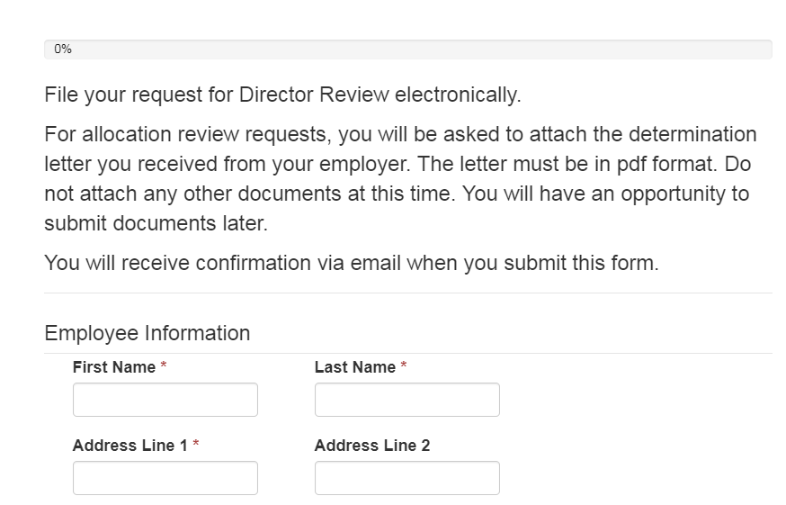
Good News!
You don’t have to provide every piece of documentation to file.
You’ll just need your notification letter and a short written statement.
So file this part immediately and keep working on your documentation.

Slide 9
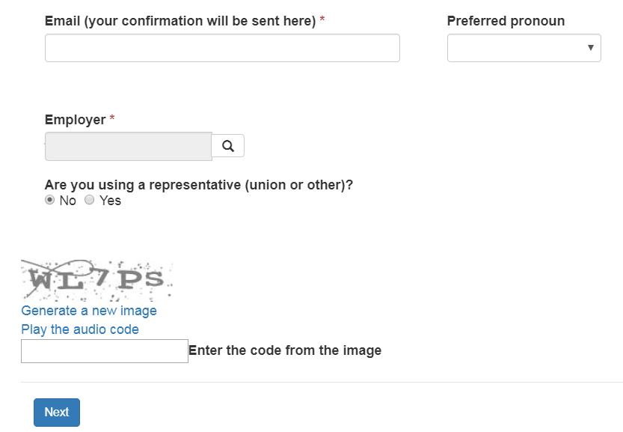
You can use either your work or personal email for this process.
Choose your Employer (agency or college) from the drop down menu.
“Representative?” Choose “No”

Slide 10
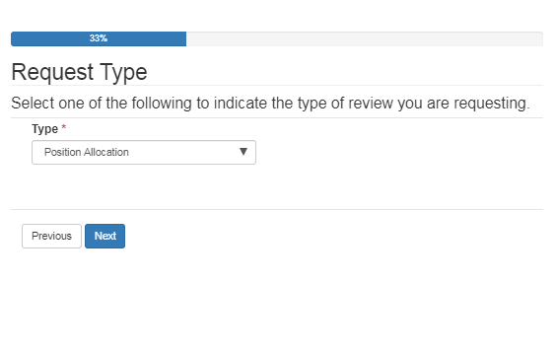
Choose “Position Allocation”
Allocation and Re-class mean the same thing.

Slide 11
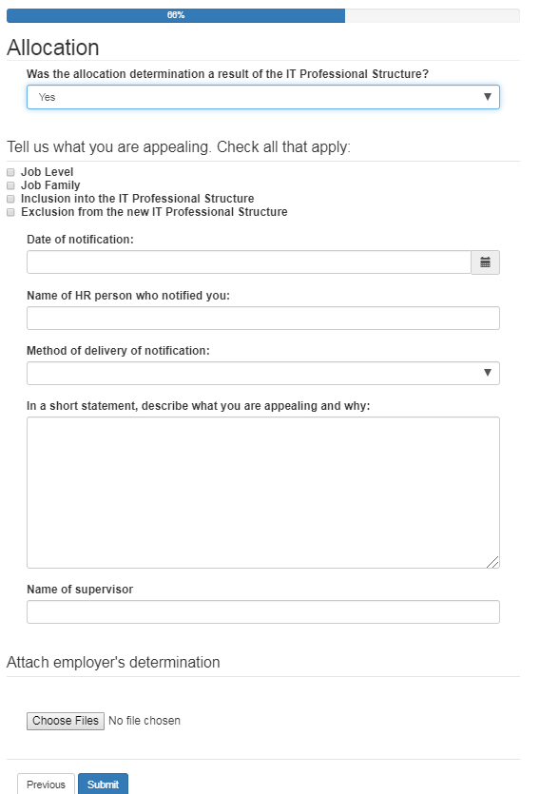
The only part you need to write prior to filing – the “short statement”
2,000 character-count limit (includes spaces)
Include PDF of your notification letter

Slide 12
The short statement
Remember that Reviewers do not have your technical knowledge. Avoid all jargon.
Start with the Rationale (if available)
Each position determined at IT User or IT Worker-Paraprofessional has an “Exclusion Rationale” – a VERY short statement on why it wasn’t determined to be IT Worker-Professional.
A few positions determined IT Worker-Professional have a similar “Recommended Job Family Rationale” if the agency/college’s recommendation wasn’t followed.
If you’re appealing either of those two issues, ask HR or WPEA for the rationale listed in the final spreadsheets. WPEA: Email Lane Hatfield (lane@wpea.org) or your Staff Rep.
This can help to know what you need to overcome!

Slide 13
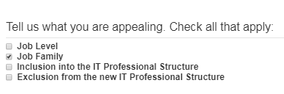
The short statement
Next: Know Where You Want to Be:
Then: Compare Your Placement to What You Want
This is the most labor-intensive part!

Slide 14
Key terms For it user designees
USERS
WORKERS
Using IT systems & services
EX: daily use of spreadsheets or Internet
EX: Extensive use of IT tools to develop products like websites, publications, databases, spreadsheets
Focus of the Work / Outcome is NOT
an IT system or service,
Computer systems analysis or programming
IT is a Tool to some other end
“Directly Involved” in
Developing,
Implementing,
Maintaining
Configuring,
Delivering
Supporting IT systems & services
Focus of Work/Outcome IS an IT system or service, systems analysis, programming
IT is both a Tool AND the product/outcome

Slide 15
IT User → IT worker statement
How to structure your Statement. This can be bullet points for space.
“Was classed as [classification from letter] should be [IT Worker – Professional OR IT Support Technician 1 or 2 (the most common class for Worker Paraprofessionals)].”
“Eval said [quote the Exclusion Rationale if it’s specific and you have the characters] but:”
Then go through the list for IT Worker on previous slide – Developing, Implementing, etc. “I develop” or “I am directly involved in” and state the work / IT system. Repeat for each.
Look through your latest PDP, if available, to help fill out this list. If you don’t have your PDP, get it from HR. If you aren’t regularly getting evaluated, start from the documents put together from this restructure (get from HR).
Read the Job Family descriptions in the Evaluator’s Handbook (p 40 +). Avoid examples listed in those under IT User. Look for applicable examples under IT Worker.
Add other activities that your PDP doesn’t include. You’ll need to document those later.

Slide 16
Key terms for paraproffessional designees
Paraprofessionals
Professionals
Does some of the activities listed under IT Worker earlier, BUT in a “supportive role” supporting other IT Worker Professionals
Support may be across multiple Job Families
Performs “operational tasks” according to “prescribed procedures” AND “under the general supervision” of an IT Professional.
So, less complexity and less decision-making authority
Apply practical knowledge or IT systems & operations.
Lower levels of formal training, education and/or relevant experience than Professionals.
Look at IT Support Tech Class descriptions for more terminology to avoid.
Work of some of the activities listed under IT Worker. Level of work is
“concerned with creative, technical, conceptual design”
“application of theoretical AND practical aspects of” Job Family fields
Direct involvement, not only supportive of others’ work
Requires decision-making related to the subject matter, consistent exercise of discretion and judgment.
For more terms related to levels of knowledge and formal training/education, look at Entry and Journey level terms.

Slide 17
IT Para → IT prof statement
How to structure your Statement. This can be bullet points for space.
“Was classed as [classification from letter] should be [IT Worker – Professional].”
Don’t need to specify proposed Family/Level. You’re appealing the “exclusion.”
“Directly performing:”
List IT Worker activities that are not setting up/supporting the work of someone else
“Performing decision-making within these projects or subjects:”
List all IT Worker activities where you can take action without someone else’s ok.
“Application of theoretical knowledge on:”
List all IT Worker activities where you are expected to find creative or new ways to do something rather than following a previously documented specific process or steps.
Look through your latest PDP if available to help fill out this list. If you don’t have your PDP, get it from HR. If you aren’t regularly getting evaluated, start from the documents put together from this restructure (get from HR).
Add other activities that your PDP doesn’t include. You’ll need to document those later.

Slide 18
IT Professional – level appeal
Evaluators used an online tool to quantify and weigh several factors to place IT Professionals into a level. We don’t have access to the tool itself, but we have the factors and the terminology evaluators depended on.
The Factors Are:
Technical Know-How
Scope of Responsibilities
Impact
Organizational Size
Scope
Accountability
Problem Solving
Much more detail on the terminology of the factors is in the Evaluator’s Handbook pages 17-29 (PDF on WPEA website).

Slide 19
Technical know-how / knowledge Entry level → journey level
Entry
Journey
Technical Know-How:
Baseline understanding of principles & theory
Developing depth of knowledge & practical application
Skilled in diagnosis, troubleshooting, maintenance. Selects most suitable available solutions/processes.
Completes routine tasks with growth toward complexity
May need some guidance on job duties
Can recommend options for unusual situations
NOTE: You may have more knowledge than your job class requires!
Technical Know-How:
Professional, working knowledge of principles, concepts & methodology in assigned areas
Work on majority of assignments independently. Help from senior staff may be required from time to time.
Focus on modification, development or maintenance of existing technology
Selects most suitable available solutions/processes.
Needs minimal guidance in addressing unusual situation.
Understands and can discuss application and implications of changes to processes, policies, procedures.

Slide 20
Technical know-how / knowledge journey level → Senior/Specialist
Journey
Senior/Specialist
Technical Know-How:
Professional, working knowledge of principles, concepts & methodology in assigned areas
Work on majority of assignments independently. Help from senior staff may be required from time to time.
Focus on modification, development or maintenance of existing technology
Selects most suitable available solutions/processes.
Needs minimal guidance in addressing unusual situations.
Understands and can discuss application and implications of changes to processes, policies, procedures.
Technical Know-How:
Advanced knowledge of a wide range of principles, concepts & practices gained through extensive experience.
Skill in applying this knowledge to complex work assignments.
Works independently on all levels of assignments.
Provides guidance to lower level staff on complex issues.
Devises methods and processes to analyze/evaluate problems. Applies theory for guidance.
Develops new processes.
Recognized as a resource to others, “the person to ask” when difficult questions arise in their area/field.

Slide 21
Technical know-how / knowledge Senior/specialist → expert level
Senior/Specialist
Expert
Technical Know-How:
Advanced knowledge of a wide range of principles, concepts & practices gained through extensive experience.
Skill in applying this knowledge to complex work assignments.
Works independently on all levels of assignments.
Provides guidance to lower level staff on complex issues.
Devises methods and processes to analyze/evaluate problems. Applies theory for guidance.
Develops new processes.
Recognized as a resource to others, “the person to ask” when difficult questions arise in their area/field.
Technical Know-How:
Demonstrates mastery of a professional field.
Consistently applies strategic expertise with comprehensive knowledge of assigned area.
Troubleshoots highly complex technical IT issues with significant levels of risk.
Research, recommend and guide integration of new technology
Takes lead in developing new processes.
Provides technical consulting and oversight on complex projects.
Intuitive grasp of situations based on deep, tacit understanding.
Understanding of full business process, strategic direction, impact on stakeholders.
Considered the “go to” person in area of expertise inside and outside the organization.

Slide 22
scope (aka level of responsibility)
How Much Work and How Wide?
These are not explicitly broken down Entry/Journey/Senior/Specialist the way Knowledge is. So instead of focusing on Key Word differences, be as detailed as possible about the variety of work you do.
How many different types of issues do you work on?
How many different systems do you work on? (not use, but maintain, etc)
How many stakeholder groups do you support? How big are they?
Look at Example language in Evaluator’s Handbook pages 22-23

Slide 23
Impact
What area(s) are directly impacted by this position’s work?
Look at the Position Objectives and Potential Impacts sections of your PDP. Are they accurate?
Have you done work recently with a wider impact than listed? Tell reviewers about that in your statement.
What would be the impacts of a mistake or a failure of your system(s) on your organization? Would there be monetary impacts? You may need to talk with your supervisor to figure this one out.
Do you work on systems that collect or distribute funds? How much money comes through them? Again, your supervisor (or the work group that uses the system) may need to help here with details.

Slide 24
Problem-solving
Similar and hard to pull apart from Technical Know-How.
Identify work you do at each level (look at list from PDP and any work log you’ve been keeping). Detail where you spend the most time, especially on the more advanced techniques.
Levels (from most to least complex techniques):
Resolves problems by applying established or routine solutions/processes/procedures. ~Para/Entry
Resolves problems requiring analysis and discernment of most suitable available solutions. ~Entry/Journey
Devises methods and processes to analyze/evaluate problems. Researches to find the best solution. ~Senior/Specialist
Problems require development of creative/innovative solutions including new methods/procedures/approaches (few state positions will be found to work at this level).
~ Expert

Slide 25
It professional – family appeal
This is where a work log is going to be important. Positions may touch multiple families, so decisions are based on two factors:
Majority of time spent
PDP/ Position Objective / purpose
Evaluators already looked at PDP’s and Position Objective, so there are two things to do.
Explain the position more clearly.
Show that majority of time is spent in another family.
Most common problem is mis-allocation into Customer Support Family.

Slide 26
Time Spent
Director’s Review Office can look back up to six months.
Look at projects/work done in last six months. Describe how those projects fit into the Job Family you want.
If you have a fairly consistent project balance, you can show this in a work log for a much shorter period.
Let your Supervisor know you’re doing this, so they can back you up if asked for information/employer’s position by reviewer.

Slide 27
Explaining/describing the work
This system does not favor organizations that have describe classified staff work mostly in how it serves/impacts end-users. A problem especially for those in the colleges.
Troubleshooting and Technical Advice: Rather than describe relationship to customer here, talk about the technical decisions and know-how used.

Slide 28
Customer support → sys admin
In flat structures or small teams, many staff do both customer support and least entry/journey level systems administration work.
Focus on Terms/Actions:
Any work done on (not in!) Operating Environments / Systems Environments
Conduct Testing
Customize, configure, extend Content Management Tools
Design and Prototype Applications
Develop, prepare, deploy system changes (develop, test, pre-production, production)
Ensure system availability, functionality, integrity
Maintain system configuration
Evaluate, select, install compilers, assemblers, utilities
Monitor systems environment
Plan installation of hardware, software, operating systems
Resolve hardware/software interface and interoperability problems.

Slide 29
Additional documentation
Job Descriptions
PDP (what was prepared for this process and any done since then)
Work Logs
Other documentation of applicable work done since last PDP
Any documentation
Assigning you to perform as lead on a project that was ongoing in last six months
Identifying you or designating you as an expert or “go to” on a topic or the trainer of/ resource for new hires

Slide 30
Additional resources
WPEA Website: http://www.wpea.org/ – under For Members then Resources
Director’s Review Training PowerPoint
Director’s Review Video Recording of Online Training
State Evaluator’s Handbook
Draft Job Class Descriptions (use these until the official copies show up on OFM site – see below)
IT Professional Structure Pay Scale
OFM Website:
Classified Job Listing – provides the official job class descriptions, including pay range (new versions were officially approved June 13 and should be on here soon) https://ofm.wa.gov/state-human-resources/compensation-job-classes/ClassifiedJobListing
Director’s Review filing site and Q&A’s https://ofm.wa.gov/state-human-resources/reviews-appeals/directors-reviews
IT Restructure Overview https://ofm.wa.gov/state-human-resources/reviews-appeals/directors-reviews

